Slide 1
Welcome Everyone!!

Slide 2
Email Scripting in Python
TCS Windows VMware

Slide 3

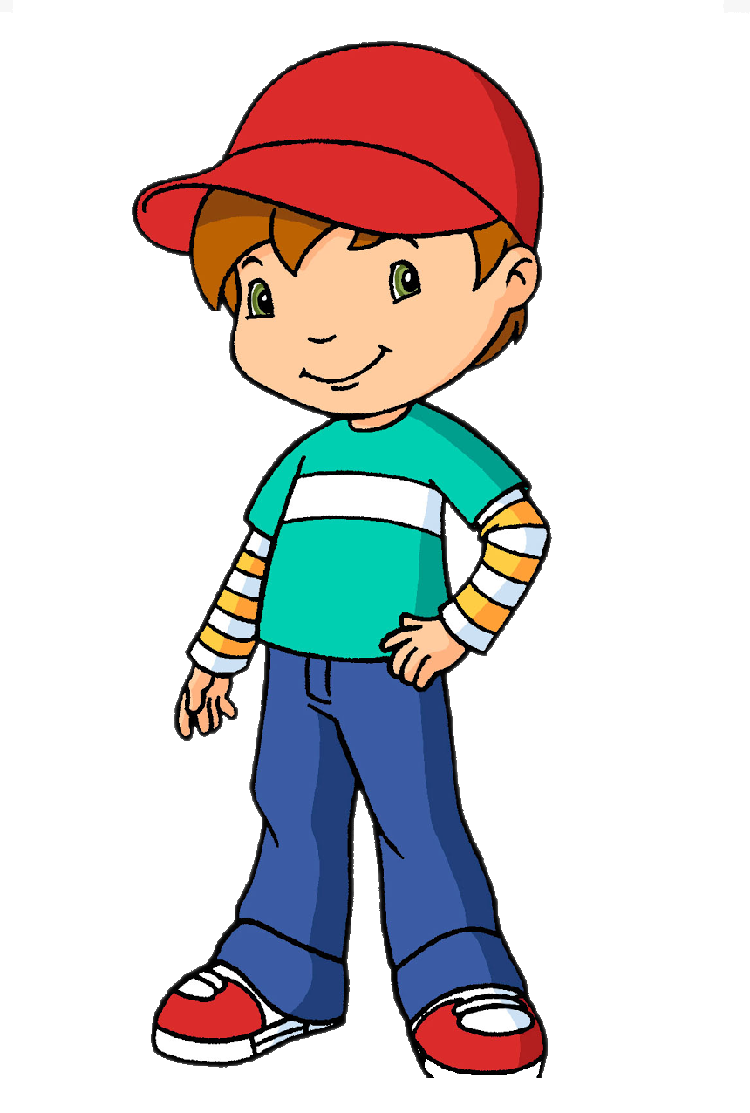

Problem Statement 01
Suppose, Vishnu is having his birthday today and as a gift he wants us to wish him on email without using Outlook (directly).

Slide 4
😇

Slide 5
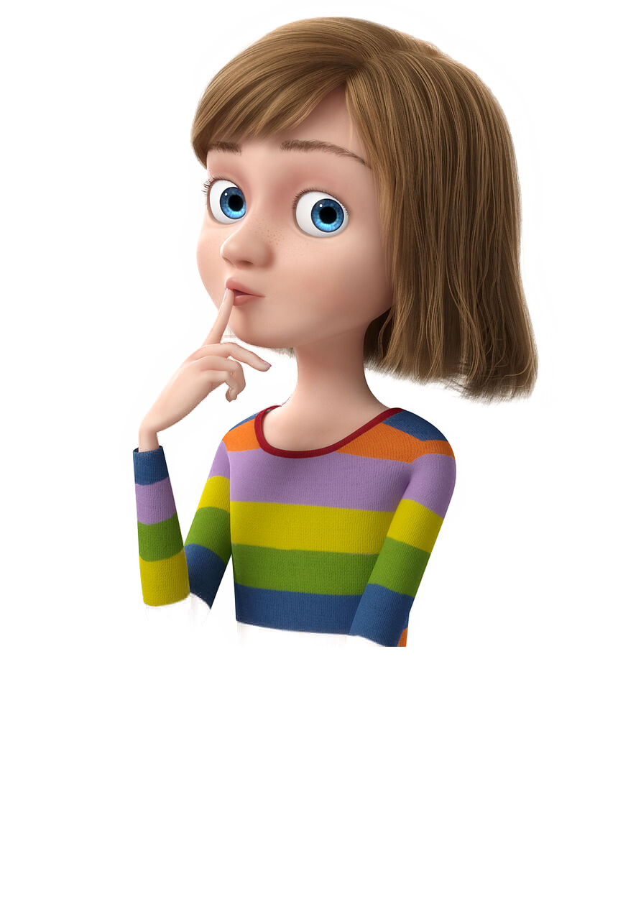
Problem Statement 02
Now, Keerthi came and said, I am also having my B'day today. Wish me as well :)

Slide 6
Problem Statement 02 Contd...
I don't want a boring wish, I need something which is more exciting (like which contains some embedded image).

Slide 7
😇

Slide 8
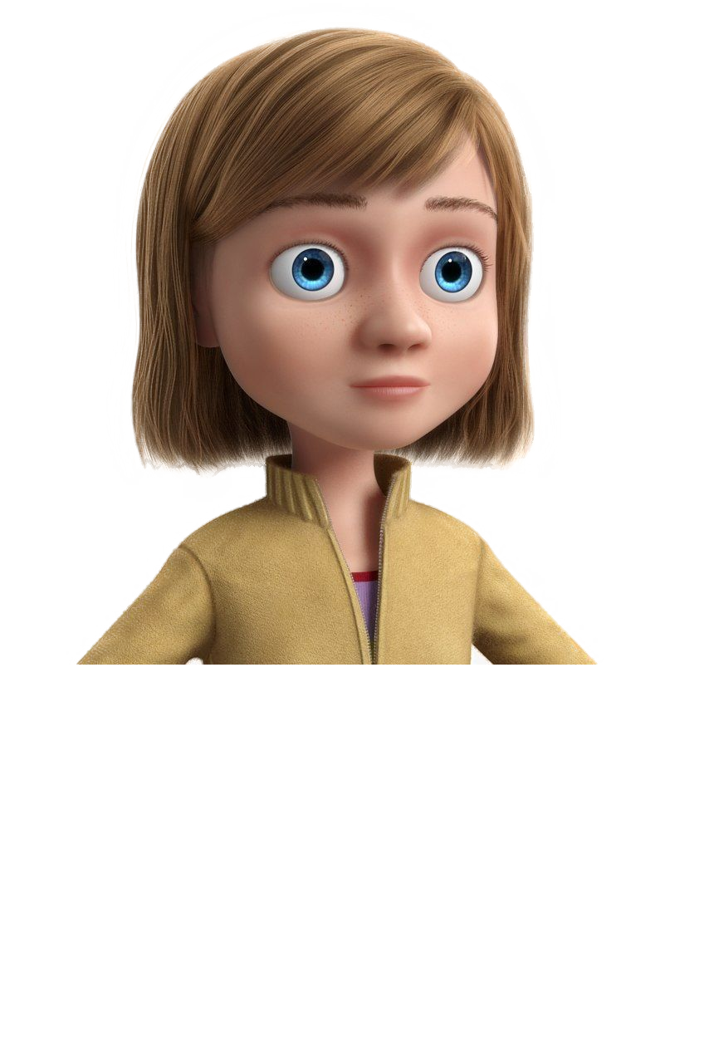
Problem Statement 03
I also need a wish...

Slide 9
Problem Statement 03 Contd...
Ofcourse, the exciting one...

Slide 10
Problem Statement 03 Contd...
But with gift as proper email attachment.

Slide 11
😇

Slide 12
Future Aspects

Slide 13
Thank You!!

